Slide 1
Bank Management System
Submitted by :
Keerthana BN
Batch code : 2021-6334
Enrollment number : EBEON1121455048

Slide 2
Application Description
The Bank Management System is an application for maintaining a person’s account in a bank.
The System provide the access to the customer to create an account ,Search accounts, Deposit / Withdraw the cash from an account.
The following presentation provides the specification for the System.

Slide 3
Module Description
Main Menu
Display All
Search By Account
Deposit
Withdrawal
Exit

Slide 4
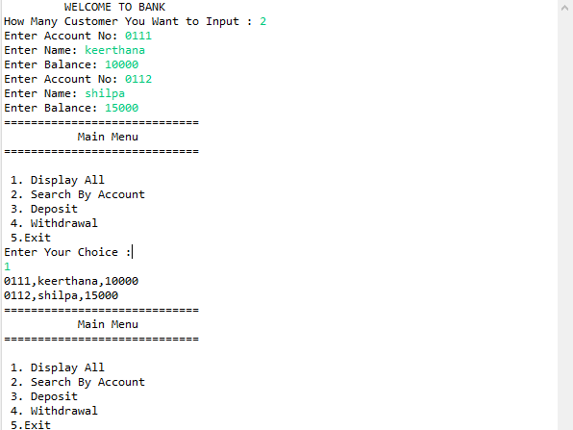
Output

Slide 5
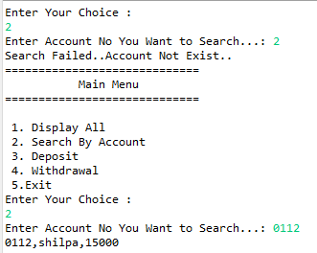
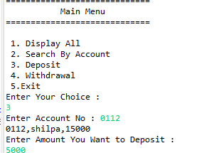

Slide 6
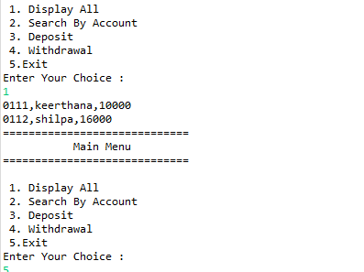

Slide 7


